Slide 1
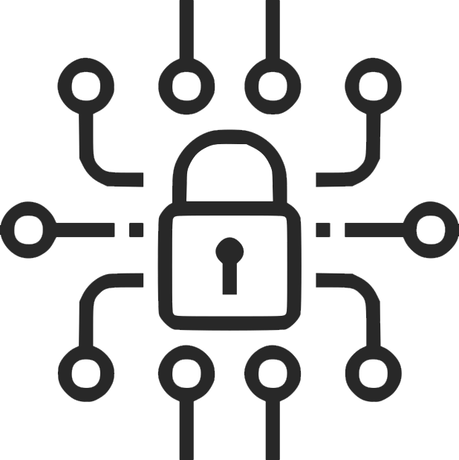
Digital
Lineup
By Olav Sharma – Tier 4
Notes:
Welcome to my Digital Lineup presentation. I’m going for tier 4. Please help me get there.

Slide 2
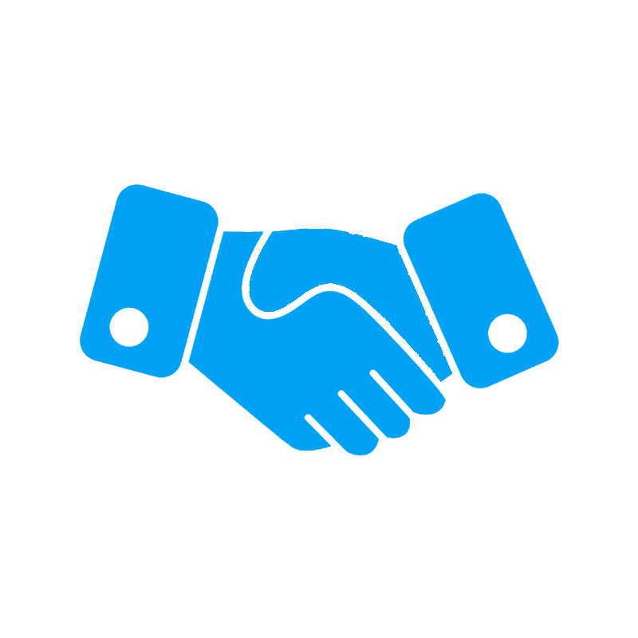

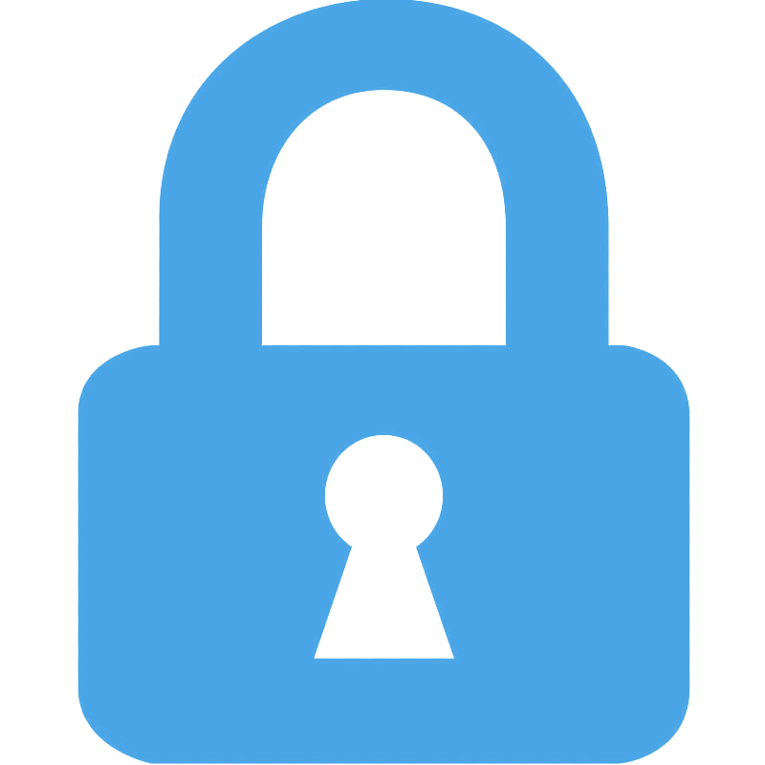
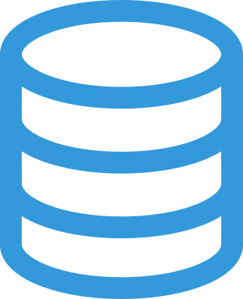
Intro
This Presentation covers the four parts of Digital Lineup,
These four parts of the Digital Lineup are key in keeping you safe, private, secure, and responsible. The next two slides cover security, the two after cover footprint, and so on.
Security,
Footprint,
Citizenship,
and Safety.
Notes:
This presentation covers the four following parts of digital lineup. Security. Digital Footprint. Digital Citizenship. And Safety.

Slide 3
Ch. 1
Security
The following slides cover securing your accounts, and the importance of security online.
Notes:
Security. Security is really important when online. Keeping your account secure is only going to get harder. The following slides talk about securing your accounts and why securing them is important.

Slide 4
Why is Security important?
Security is important due to several reasons. Three important reasons are below.
Secure accounts keep your personal info private. Lots of companies store your full name, date of birth, phone number, and sometimes more information. When people log into your accounts, they can usually see some of this information.
Bank accounts or similar. Nowadays, lots of services such as Google, Samsung, or similar keep your payment methods saved on your account. This makes it simple for people to use your own money. Lots of these services save virtual cards used for real-life payments using NFC. This means people can use your money in real life too!
Access to a Google, Microsoft, Samsung account or similar grants other account passwords. Many services such as Google, Microsoft, and Samsung. Store passwords for other services in the cloud. Some examples are Google’s password manager, Samsung Wallet Pay, and Microsoft’s password service. This is usually only vulnerable if they use these services though.
Notes:
Security is important for several reasons including, keeping your info your info, keeping your money and bank accounts safe. Keeping all your other accounts safe too maybe.

Slide 5


Secure your accounts
Securing your accounts is important, due to how common for people to hack accounts nowadays.
To secure your accounts, some steps include
Use a strong, unique password: numbers, letters, or symbols. The harder to crack, the better.
Use 2FA or two factor authentication. 2FA keeps your account secure in case hackers have your login info. Some great apps include Google & Microsoft authenticator.
Monitor your account. Many sites give you email notifications when others log in. Make sure these are on.
Be aware of attacks. Be aware of all attacks such as phishing, data breaches, and other common attacks. Understanding these attacks can help you secure your accounts better.
Notes:
Securing your accounts is simple. Some steps to follow include using a strong and unique password. Using 2FA. Monitoring account history. Being aware of the attacks.

Slide 6
Ch. 2
Digital Footprint
The following slides cover how data is stored, and data breaches.
Notes:
Digital Footprint. These slides are about what Digital Footprint is and the significance of what you do online.

Slide 7
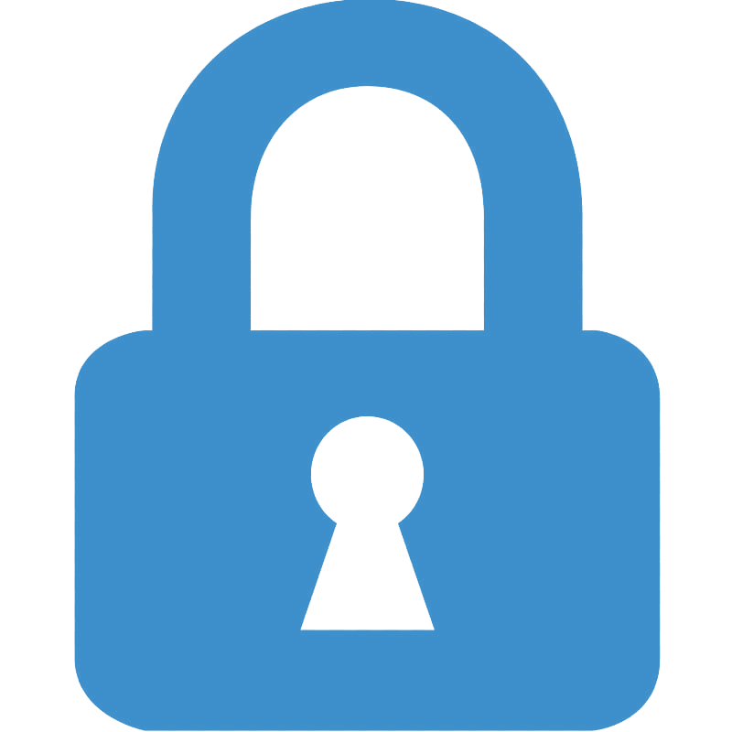
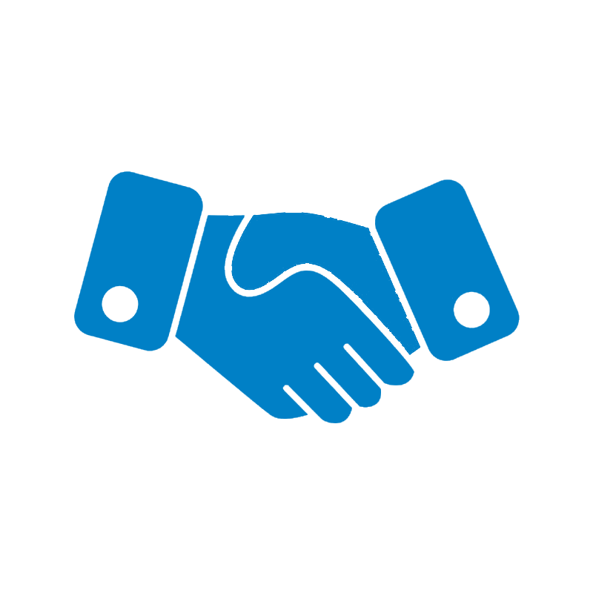

How is your data stored?
Data is stored in database. Databases are servers operating in companies’ building with lots of storage.
When you save something in the cloud, the data gets sent to the companies’ servers, and is stored there.
Lots of the time, these servers aren’t used for just cloud services such as Microsoft OneDrive or Google Drive but are also used to store other things such as chat history, images, all kinds of user data, and more.
An important thing to keep in mind is that when you delete messages or anything online, you are usually deleting it locally, or in the frontend, what other users see. Deleted data is still stored by bots which log everything that happens online, or in the companies’ databases, except it’s not displayed on the frontend. This is due to several reasons including advertising, data collection, and more.
You can delete your data by making a request to the company to. If third-party bots, or loggers have your data though, they’re probably going to keep it.
Remember, what you do on the internet stays there.
Notes:
An important part of understanding digital footprint is understanding how data is stored. Companies have large servers to store your data. This usually includes things you upload, data they collect, chat history, and more. A key thing to keep in mind is that your data will stay there, you can ask companies to remove it, but bots online usually have already logged it. When you delete something, it can appear deleted. On the outside or frontend, it is. But the data remains in the companies’ databases. This is why it’s called digital footprint. It’s your footprint online, what you leave there. Here’s a quick little diagram.

Slide 8

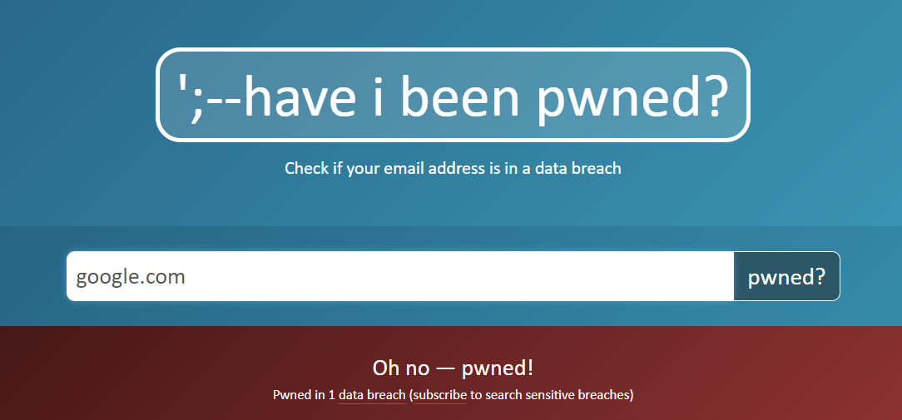

Data Breaches
These breaches are starting to become really common, represented by this graph.
2019: Breaches on the rise
2020: With the pandemic, people use computers more and more often. More information to steal.
2021 Even more people use computers on a daily basis, lots of information to steal.
2022 Even more info to steal. These are only going to rise.
Data breaches are when companies’ databases get breached and leaked to the hacker.
These are dangerous because databases hold everything that these companies know about you, including information you’ve given them.
Some companies choose to store different information in different databases and is becoming more common for them to have different encryptions. This is a step in the right direction to cut these breaches out.
Most of the time, the most vulnerable information other than personal information, your account password.
Hackers can use the passwords they find in data breaches, match them to the username, and use them to decode passwords to other site logins. A way to counter this is to use different passwords for different sites.
If you would like to find out if you’ve been in a breach, you can go to haveibeenpwned.com.
Notes:
Data breaches. Data breaches are when hackers hack these databases which store your data. They do this to collect the information these companies’ have stored about you. Once they collect this information, the thing they’re usually looking for is the login info, because most people use similar passwords for different services, hackers try to use the password to try and guess other passwords making bruteforcing other accounts a bit easier. This is also why it’s important to use a strong password as said earlier. You can check if you’ve been in a data breach using many services online, one being “have I been pwned?”. Not only that, but they can also hold you accountable for what you do online. Especially stuff you regret, highlighting what you do online stays online.

Slide 9

Ch. 3
Safety
The following slides cover how to stay private, how to stay safe, and why safety is so important.
Notes:
With that out of the way, safety is next. Erm, okay. Well. Safety.

Slide 10
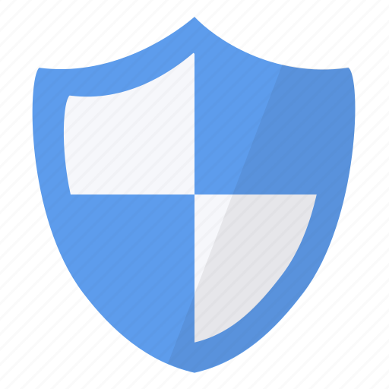
Understanding Safety Online
Safety is number one when online. Some key parts of understanding safety when online include
Privacy: Keeping your info YOURS.
Safe Browsing: Learning how to stay safe when browsing
Approaching safety comes in many more forms than this but these are overall the top three. The next slide covers some of the best practices and recommendations for these subjects.
Notes:
Privacy is keeping your information yours and safe browsing is learning how to stay safe while browsing

Slide 11
Best Practices for Privacy
Staying private online can be a bit overwhelming but is worth it. Some important practices are to…
Use a VPN when available
Decline website cookies
Try not to use public Wi-Fi
Share locations with apps only if necessary
Share only necessary information to companies
Keep tabs on what info people have about you
Notes:
Use a VPN decline cookies don’t use public Wi-Fi share locations with apps if you need and keep tabs on what people know about you

Slide 12
Browse Safely
Browsing safely is important for staying safe online. Browsing safely can keep your information more private, contributing to the last slide, and can keep you on topic. Great practices for browsing safely may include…
Use a safe browsers such as Firefox or Brave
Use a safe search engine such as DuckDuckGo, Brave, or some that don’t collect your info.
Decline cookies if you don’t want companies to track everything you do on their websites.
Notes:
Browse safely recommendations include safe browsers safe search and to decline cookies

Slide 13
Ch. 4
Citizenship
The following slides cover how to be responsible online, and why it’s so important.
Notes:
Citezenship

Slide 14

The Importance of Responsibility Online
Responsibility online should be considered the same if not more important that responsibility in-person. Keeping integrity online can help in many areas when talking to others online and staying safe. Your online profile can be easily tracked to you, so make sure that whenever you do something online, you would feel comfortable doing in real life. This is talked about in Digital Footprint where companies store everything about you. Combining the data these companies’ have it’s easy. Responsibility is important for several reasons, some of the most important being
Being a good person online to others
Staying safe and private online
Staying on topic
Notes:
The importance of responsibility online includes being a good person staying safe and private and staying on topic

Slide 15

Be Responsible
Being responsible is a key part to citizenship online. The most important after safety.
Being online doesn’t separate you from outside of online. Your data can be linked to you through these companies’ many databases.
How you talk to people what you do. That’s all linked to you. Many people act different than how they do in person when online.
This is deceiving and makes it more challenging for you to know who you should be talking to online, don’t be that person to other people. But don’t share everything about yourself as well.
Share your information responsibly. This is important for safety as well. When you share too much information online, finding who you are in person is even easier without these databases.
Notes:
Be responsible online. Online you and you are the same you. The data can be linked from an online profile to a real one. A good rule of thumb is to only do things would in real life share information responsibly

Slide 16
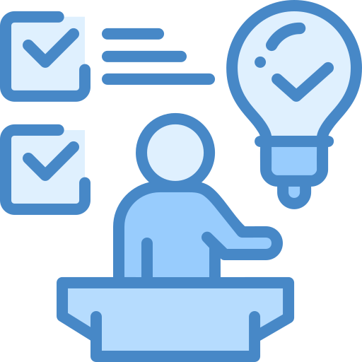
Ch. 5
Conclusion
The “Conclusion” section covers similarities & differences and works cited.
Notes:
Conclusion to all the slides

Slide 17
Security
Footprint
Protects data from attacks and threats
The trail of data left behind from users
Common
Promote responsible use of tech
Ethical
Influential
Similarities & Differences
Safety
Citizenship
Personal safety from problems online
Being a good person online
Notes:
Similarities and differences. Security is the protection from attacks. Footprint is the trail of data left behind Safety keeps users safe from problems online Citizenship is being a good person online Things they have in common include promoting responsible use of tech they’re ethical and influence you

Slide 18
Works Cited
Common Sense Edu. “What Is Digital Citizenship?” Common Sense Education, 2023,
www.commonsense.org/education/digital-citizenship/what-is-digital-citizenship.
Consumer Reports. “How to Manage Your Digital Footprint.” Consumer Reports, 2023,
www.consumerreports.org/digital-security/managing-your-digital-footprint-a7358432645/.
FederalTradeCommision. “Online Security.” Consumer Information, 2019,
www.consumer.ftc.gov/topics/online-security.
Get Safe Online. “Get Safe Online.”
Www.getsafeonline.org, 2023, www.getsafeonline.org/protecting-yourself/.
Kaspersky. “What Is Cyber Security?” Kaspersky.com, 2019,
usa.kaspersky.com/resource-center/definitions/what-is-cyber-security.
Mary Beth Hertz. “How to Teach Internet Safety to Younger Elementary Students.” Edutopia, George Lucas Educational Foundation, 4 June 2012,
www.edutopia.org/blog/internet-safety-younger-elementary-mary-beth-hertz.
Norton. “The Importance of Cybersecurity.” Norton 360, Norton, 2024,
us.norton.com/internetsecurity-how-to-the-importance-of-cyber-security.html.
StaySafeOnline. “Understanding Your Digital Footpint.” StaySafeOnline, 2023,
staysafeonline.org/blog/understanding-your-digital-footprint/.

